Slide 1
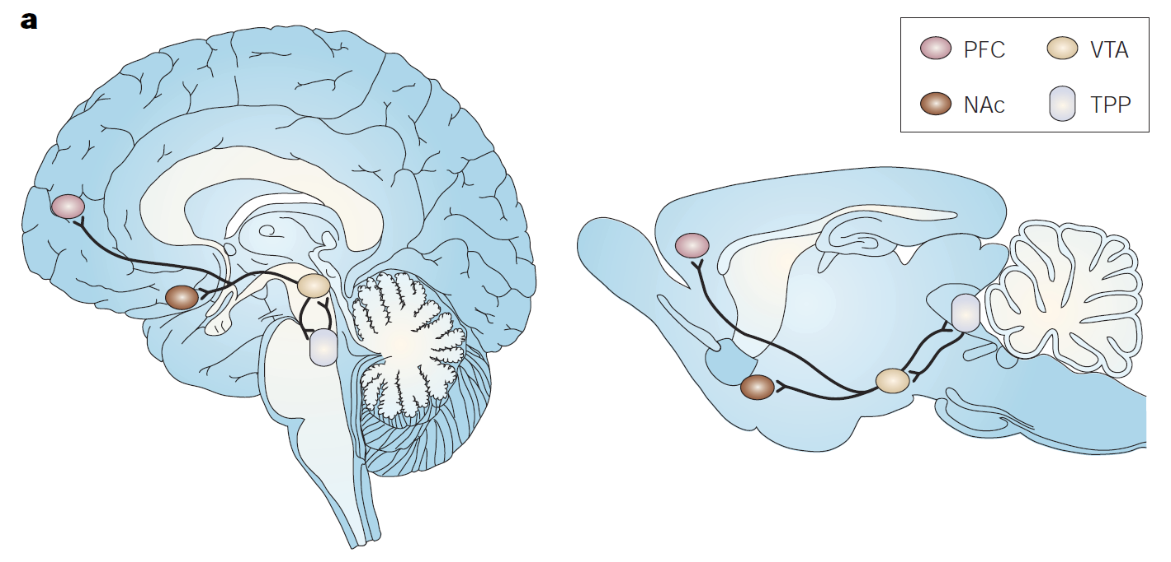
Can you become addicted to food?
Metabolic Diseases
Lesson 3.4

Slide 2
Do Now
How do we know when to eat and when to stop eating?
Do you think people can become addicted to food?

Slide 3
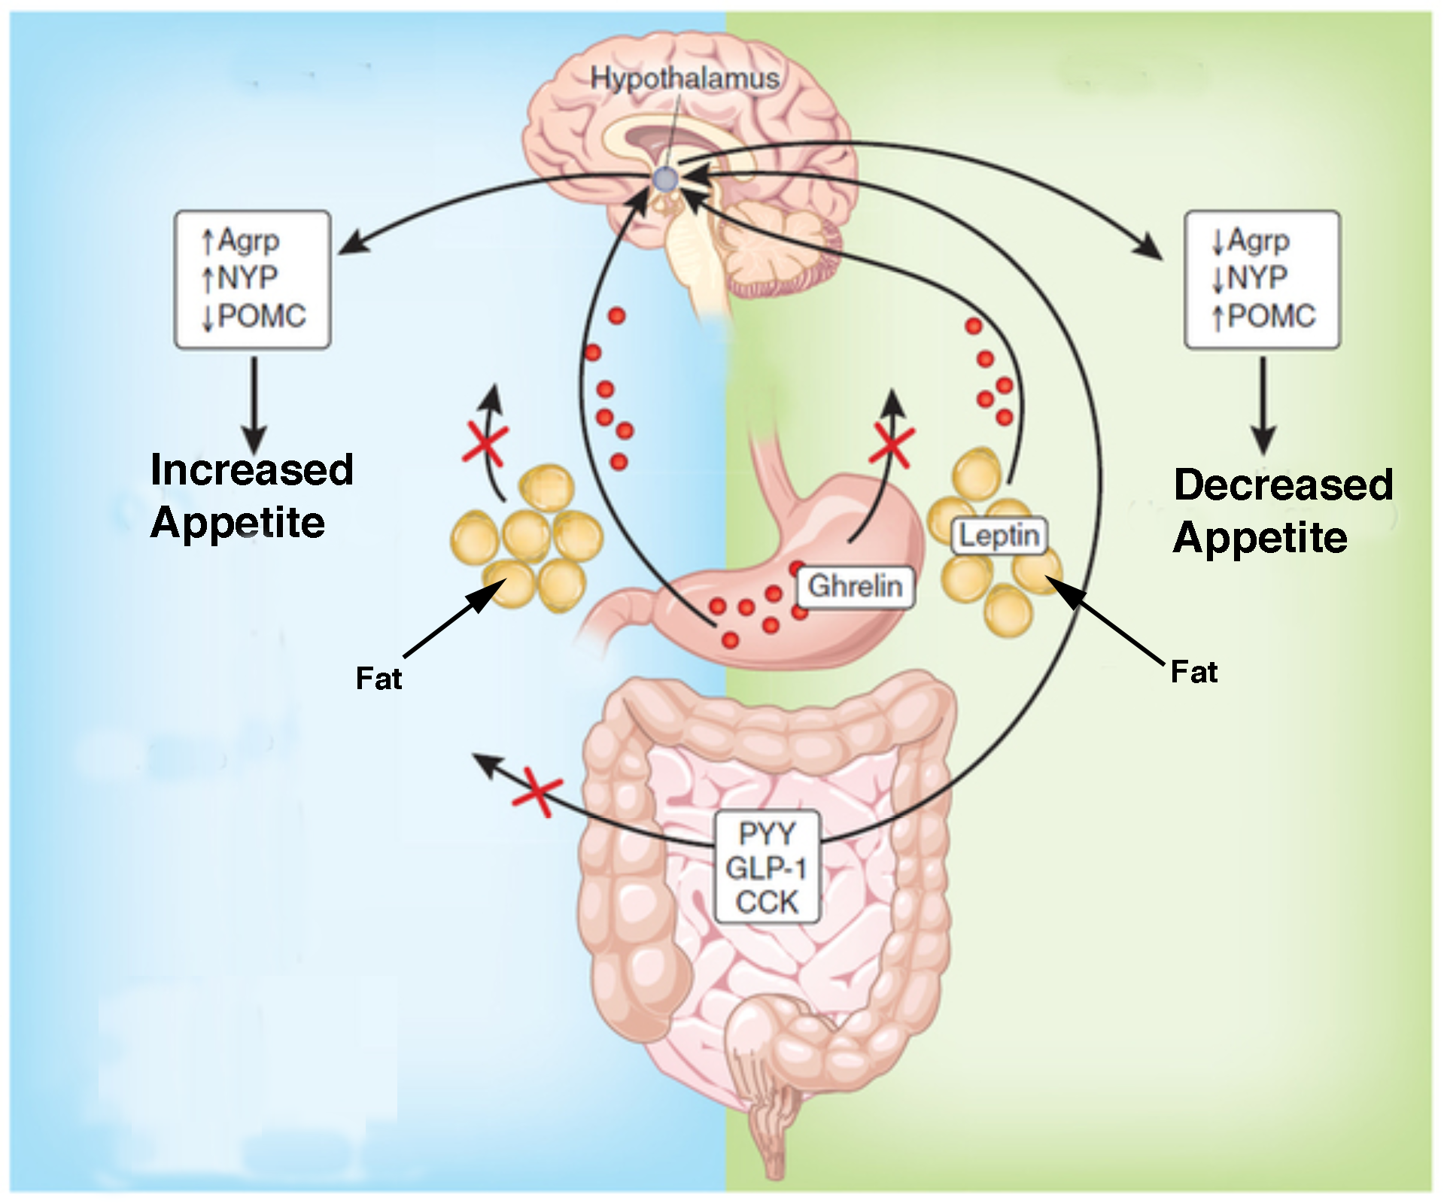
Hunger and Satiety Signals
Fasting
Feeding
⬆AGRP
⬆NPY
⬇AGRP
⬇NPY
Leptin
Grehlin
PYY
CCK
Notes:
There are many signals from the periphery that play a role in signaling energy needs. Ghrelin is a hormone secreted by the stomach in anticipation of food and is associated with hunger.
Insulin and glucose spike in the blood after eating a meal and signal fullness.
The adipose tissue itself secretes a hormone called leptin. The amount of leptin secreted increases with more fat stores and therefore reflects the amount of energy stores available.
The hypothalamus regulates our response to these physiological signals to eat. Grehlin acts on hunger center in the hypothalamus and causes an increase in appetite. Leptin, Insulin, PYY, and CCK act on the satiety center in the hypothalamus and cause a decrease in appetite.

Slide 4
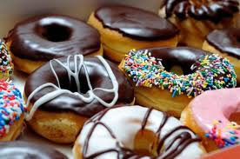
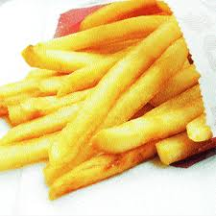
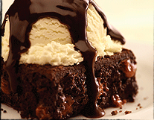
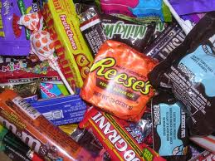
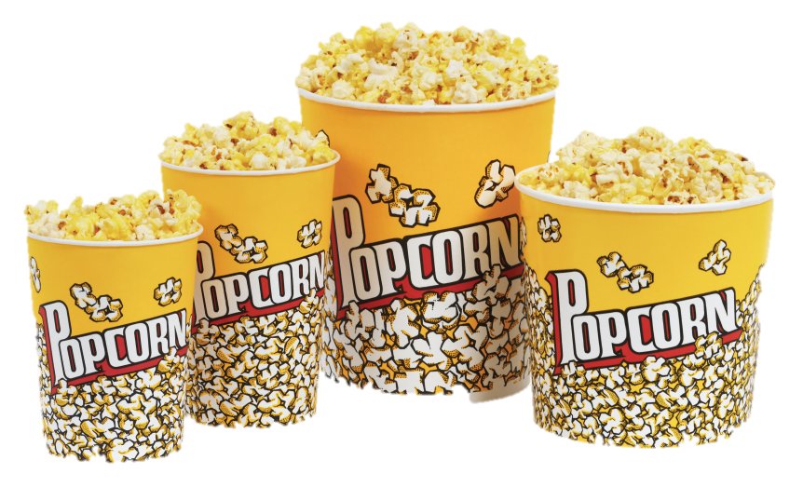
But do you ever eat when you’re not actually hungry???
Why do you?

Slide 5
Eating in the absence of hunger
External cues
  Sight or smell of food
Eating feels good
  Involvement of Dopamine Reward Pathway

Slide 6
Dopamine Reward Pathway
Pleasurable stimuli
(i.e. Drugs of abuse)
PFC
NAc
Repeat Behavior
VTA
VTA – Ventral Tegmental Area
NAc – Nucleus Accumbens
PFC- Prefrontal cortex

Slide 7
Can you become addicted to food?
Let’s investigate the similarities between drug use and food consumption:
  Effect on the reward pathway
  Existence of intense cravings
  Role of genetics and environmental factors
  Involvement of stress
  Development of tolerance and withdrawal
  Effect of overconsumption on brain structure

Slide 8
Activity
Jigsaw: Can you become addicted to food?
  Complete one of the readings as a group.
  Prepare to describe what you find to the class using the worksheet as a guide.
  Present to the class – 2 minutes!

Slide 9
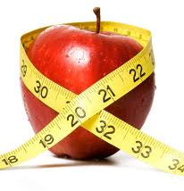
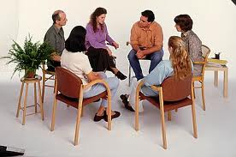
Learning from Addiction - Treatment
Treat both physiological and behavioral effects.

Slide 10
Wrap Up
What are the similarities between drug and food addiction? What are the differences?

Slide 11
Homework
Complete the reading Applying lessons from preventing and treating drug addiction to prevention and treatment of obesity.
Answer the questions.

